Slide 1


Executive Summary of Activities
February–October 2025
Presented to IHS Towers (Founding Partner & Sponsor)
By Temi Kolawole, Managing Director

Slide 2

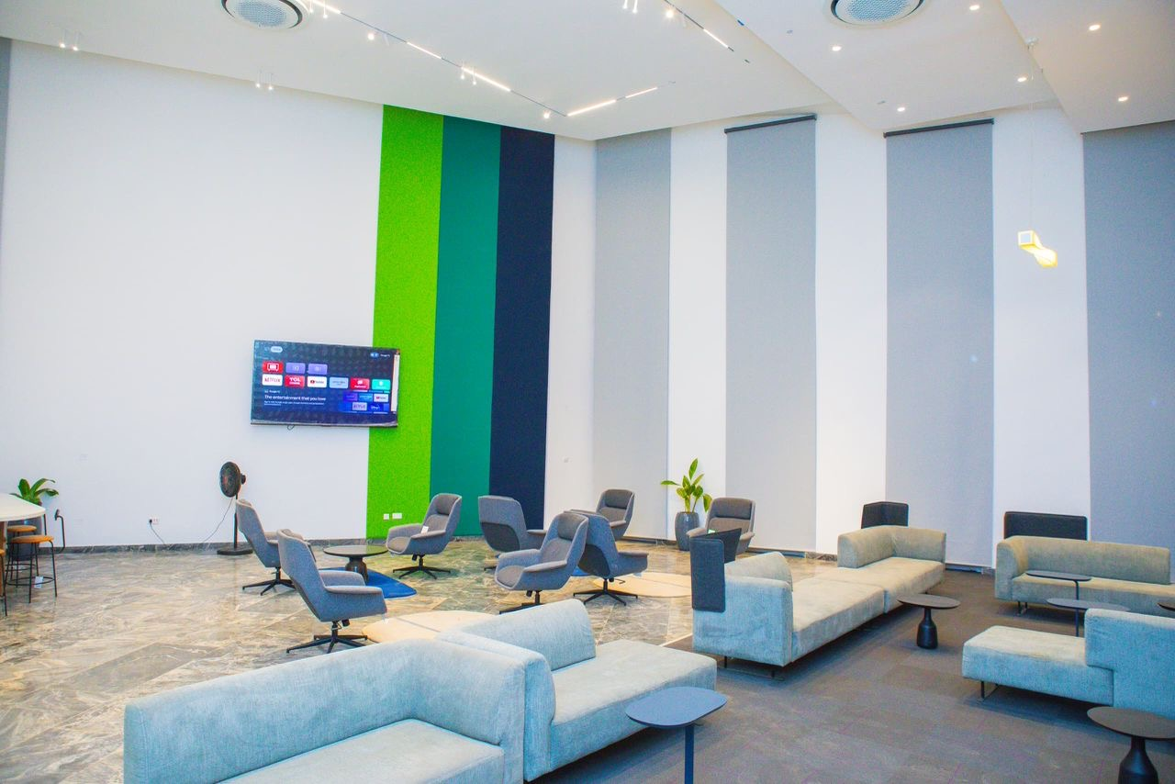
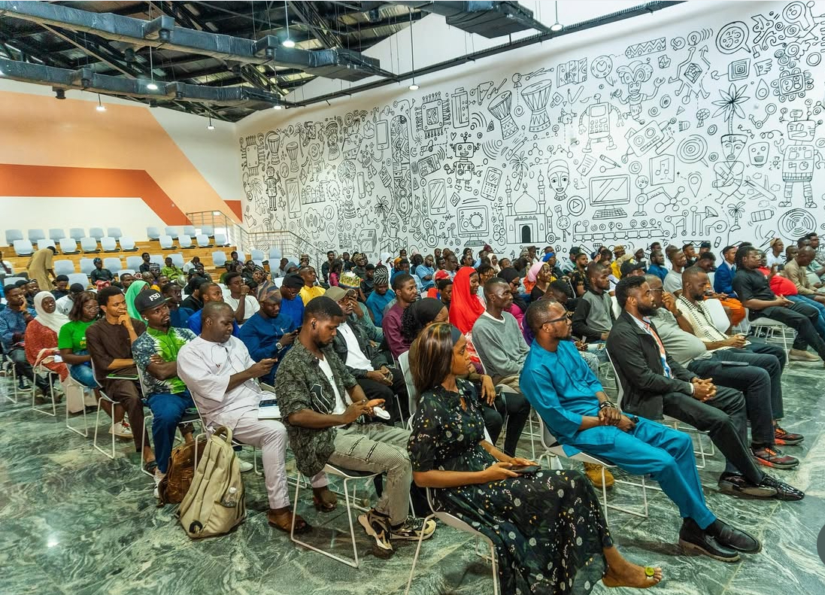

Executive Summary of Activities
Introduction
Since commencing operations in early 2025, the Ilorin Innovation Hub (IIH) has established itself as a major center for innovation, entrepreneurship, and digital transformation in North-Central Nigeria. Through the partnership between IHS Towers and the Kwara State Government, the Hub has executed impactful programs, developed talent pipelines, strengthened infrastructure, and expanded access to technology-driven opportunities.
Between February and October 2025, the Hub executed more than 70 programs and engaged over 3,800 participants across technology, entrepreneurship, and creative sectors—with strong youth and female participation.
Highlights include the launch of the Kwara Innovation Challenge and Hackathon, the onboarding of over 850 ORBIT interns, major community and youth programs, and recognition of an IIH-affiliated startup at the Africa Deep Tech Challenge 2025.

Slide 3
Executive Summary of Activities
Introduction
Since commencing operations in early 2025, the Ilorin Innovation Hub (IIH) has established itself as a major center for innovation, entrepreneurship, and digital transformation in North-Central Nigeria. Through the partnership between IHS Towers and the Kwara State Government, the Hub has executed impactful programs, developed talent pipelines, strengthened infrastructure, and expanded access to technology-driven opportunities.
Between February and October 2025, the Hub executed more than 70 programs and engaged over 3,800 participants across technology, entrepreneurship, and creative sectors—with strong youth and female participation.
Highlights include the launch of the Kwara Innovation Challenge and Hackathon, the onboarding of over 850 ORBIT interns, major community and youth programs, and recognition of an IIH-affiliated startup at the Africa Deep Tech Challenge 2025.

Slide 4
Executive Summary of Activities
Key Highlights
Over 70 programs and initiatives executed across innovation, entrepreneurship, and digital skills.
More than 3,800 participants engaged across all activities.
Approximately 1,400 women and girls trained or empowered through inclusive and youth programs.
850 interns onboarded under the ORBIT Internship Program.
738 learners participated in the Learn2Earn digital training challenge, with 85 completions.
Launch of the Kwara Innovation Challenge and Hackathon, including a regional roadshow across Kwara, Kogi, Niger, FCT, Ekiti, Oyo, Ondo, and Osun.
Incorporation of Ilorin Innovation Hub Ltd/Gte in July 2025, formalizing the entity jointly owned by the Kwara State Government and IHS Towers.
AI in Nigeria Community Launch in May, fostering collaboration among AI practitioners nationwide.
Fireside Chat with Iyin Aboyeji and Virtual Townhall featuring Kazeem Oladepo, Chris Folayan, Anu Adasolum, and Iyin Aboyeji, connecting founders and investors.
3rd FETICON Student Colloquium (May 28–29) sponsored by IHS Towers, strengthening university-industry collaboration in engineering and innovation.

Slide 5
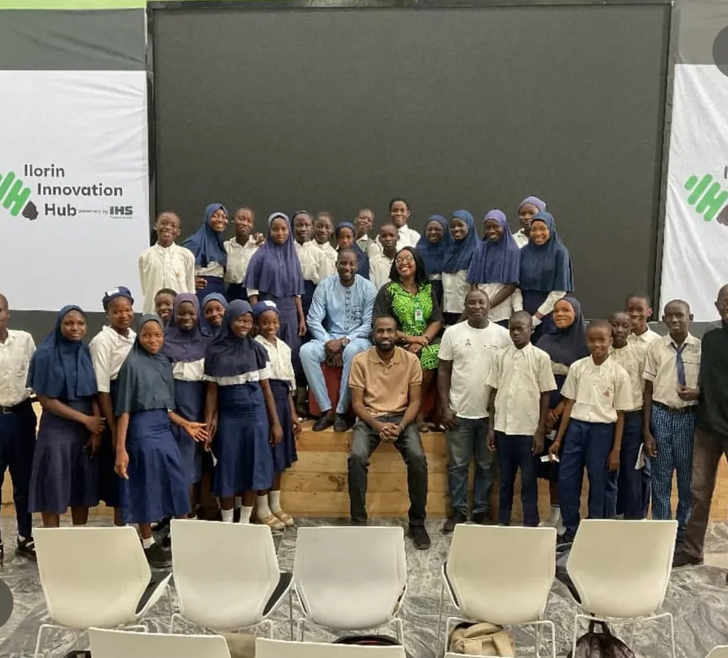
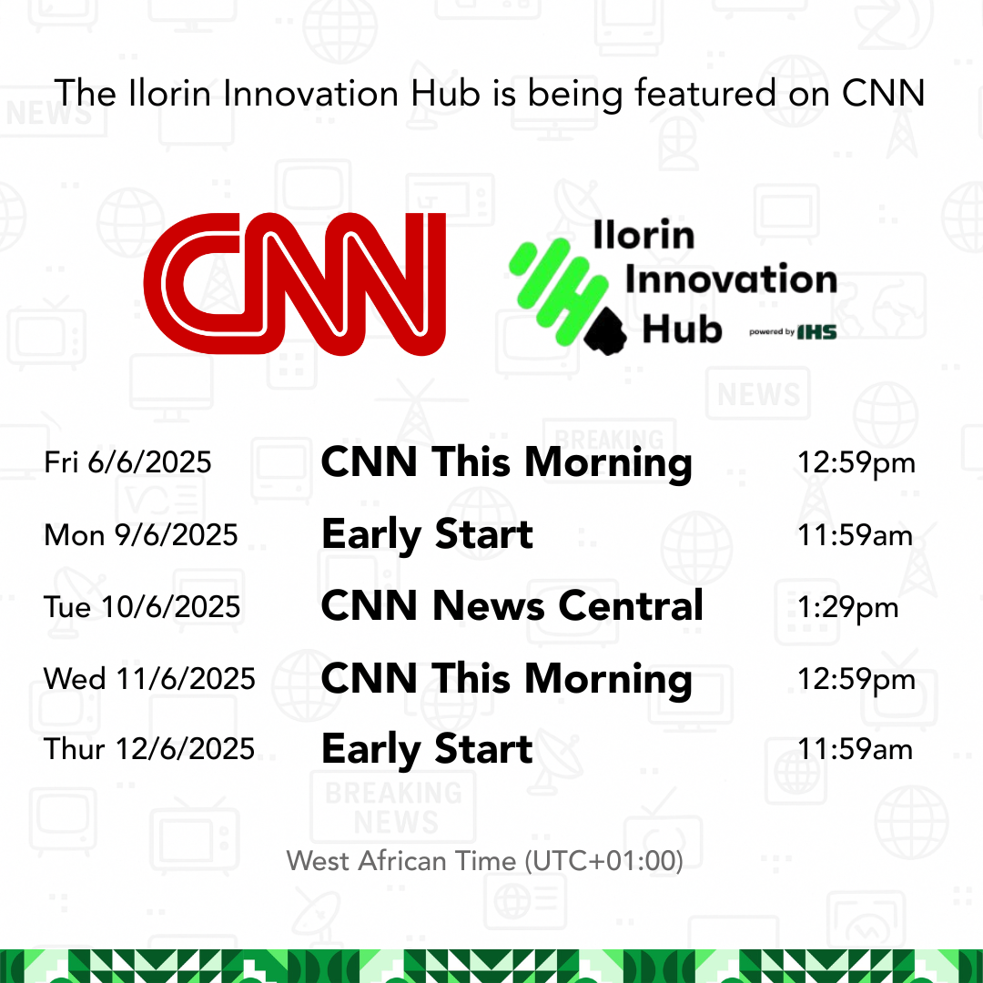
Executive Summary of Activities
Key Highlights
STEM Africa Fest in July attracted over 600 participants, making it one of the largest STEM-focused gatherings in the region.
AI for Women Bootcamp (September) and Creative Tech & Future of Digital Studios event spotlighted digital inclusion and creativity.
CNN Africa Feature on IHS x Ilorin Innovation Hub’s growing impact and ecosystem story
AI Independence Bootcamp for Kids (October) trained 200 students in AI and creative problem-solving.
Program Kick-off and Art Hackathon (February 27) marked the relaunch of IIH’s creative-tech programs.
Future African Space Explorer STEM Academy (FASESA) hosted at IIH with IHS support, engaging youth in space and robotics learning.
Managing Director represented IIH at GITEX Africa 2025, speaking on the panel “One African Silicon Valley or Many?” alongside global innovation leaders.
International visibility through participation at Ai4 Conference (Las Vegas) and Lagos Business School AI Scaling Hub Workshop.
Facility milestones achieved: elevator installation, UNDP Makerspace setup, external solar lighting, and cafeteria activation.

Slide 6
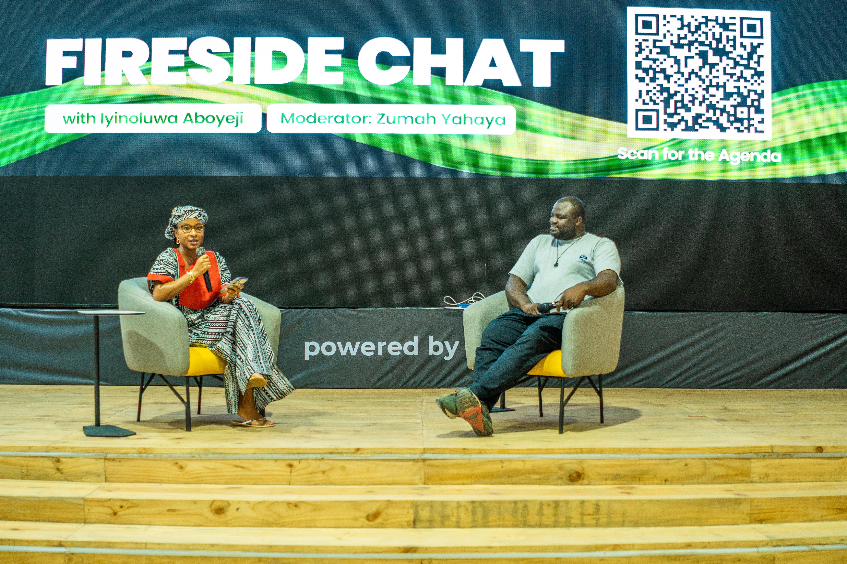
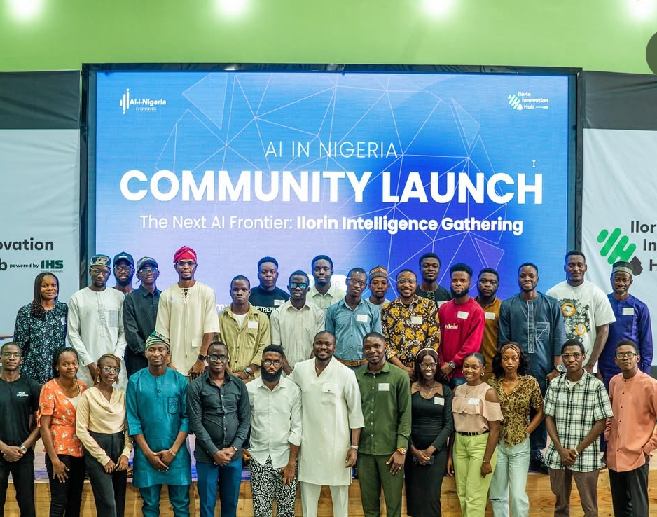
Executive Summary of Activities
Q1 — Foundation & Early Engagement (February–May 2025)
Key Highlights
Program Kick-off and Art Hackathon on February 27 signaled the Hub’s operational relaunch.
Visit by the U.S. Embassy in April to initiate plans for an American Space at the Hub.
Build with AI event with student community GDG UNILORIN introduced practical AI learning for students.
May featured high-impact programs: AI in Nigeria Community Launch, Fireside Chat with Iyin Aboyeji, and the Virtual Townhall with top industry leaders.
The 3rd FETICON Student Colloquium (May 28–29), sponsored by IHS Towers, connected engineering students from across the region to industry experts and innovators.

Slide 7


Executive Summary of Activities
Q1 — Foundation & Early Engagement (February–May 2025)
Impact Metrics Over 900 participants engaged during this foundation phase, building the base for subsequent program scale-up.
Milestones Operational setup completed, staff hiring commenced, and early partnerships activated with IHS Towers, UNDP, and CcHub.

Slide 8
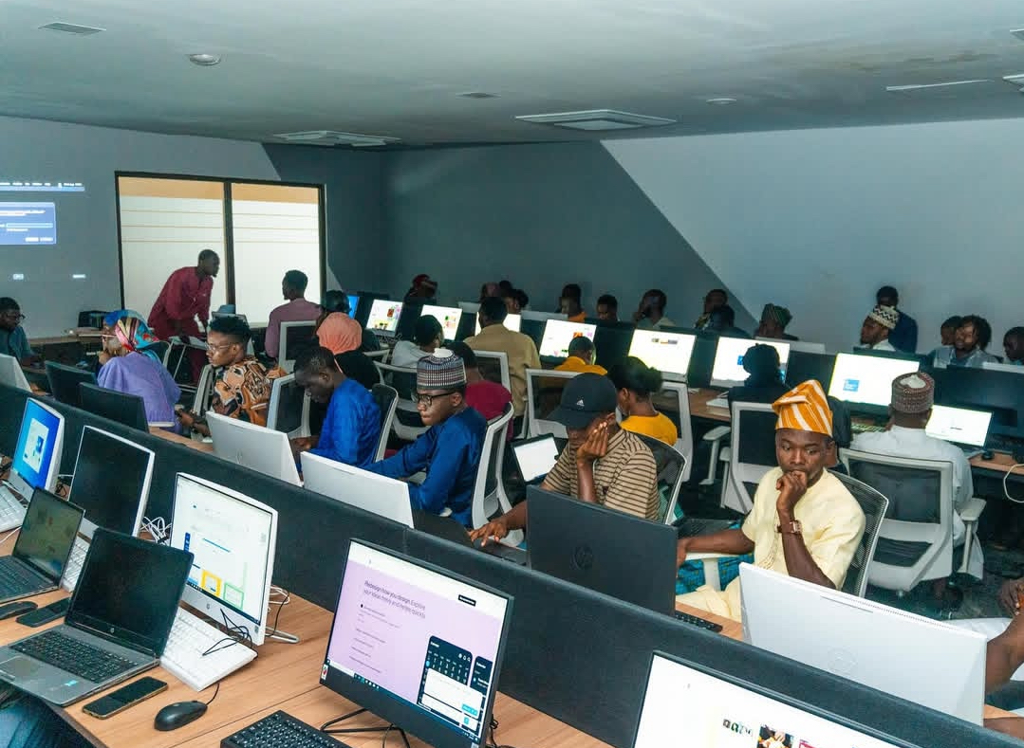
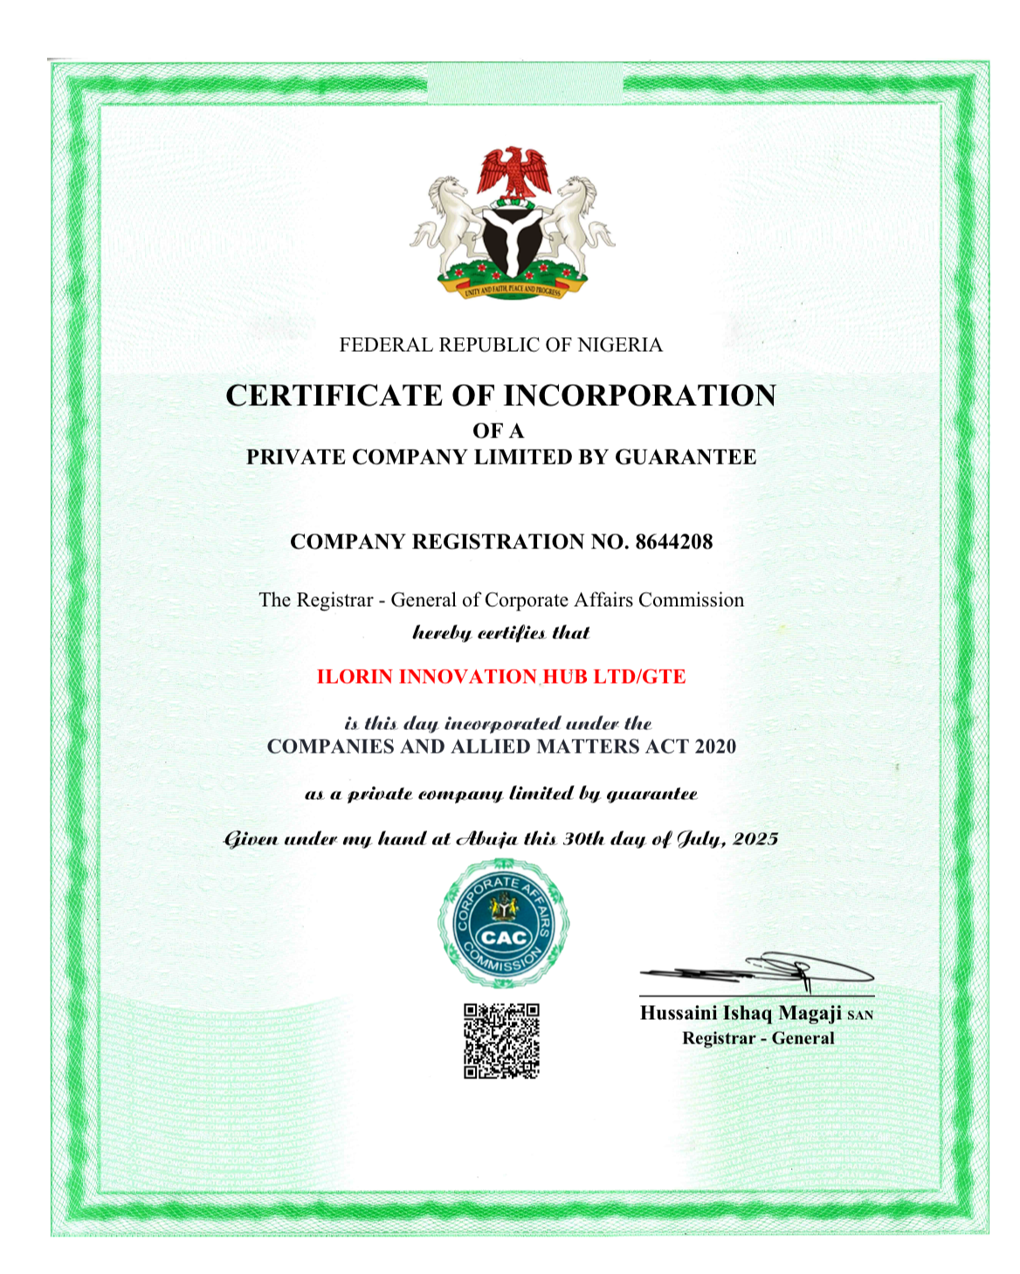
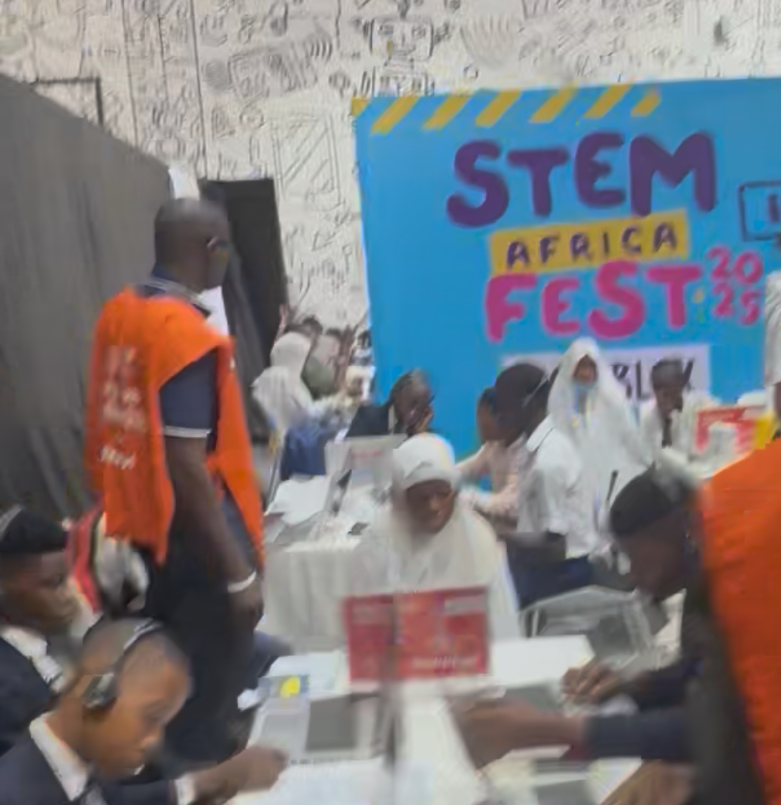
Executive Summary of Activities
Q2 — Growth & Ecosystem Building (June–August 2025)
Key Highlights
Launch of DevBox, Builder’s Path, and Entrepreneurship Masterclass
Kwara Innovation Challenge & Hackathon with regional roadshows across 8 states
STEM Africa Fest with 600+ students and educators
Future African Space Explorer STEM Academy (FASESA) hosted with IHS support
Tech for Market Women (with Mastercard Foundation) and SUI Blockchain Meetup
Design Thinking Bootcamp, Human-Centered Design Workshop, Gemini API DevBox
Cybersecurity Webinar and Meet & Mingle 1.0
Incorporation of Ilorin Innovation Hub Ltd/Gte finalized

Slide 9
Executive Summary of Activities
Q2 — Growth & Ecosystem Building (June–August 2025)
Impact Metrics 1,800+ participants across June–August (avg. 70% attendance)
Milestones First major kids event at the hub held – STEM Fest Africa
Incorporation formalized governance and structure; Representation at Ai4 Las Vegas & LBS AI Scaling Hub Workshop

Slide 10
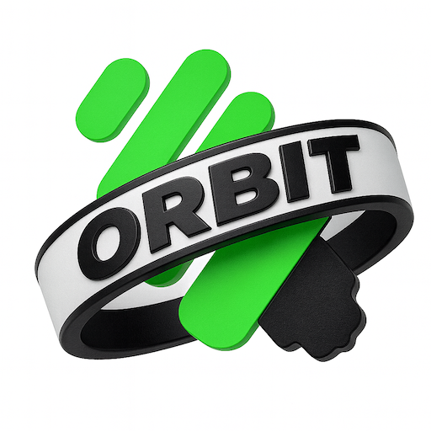
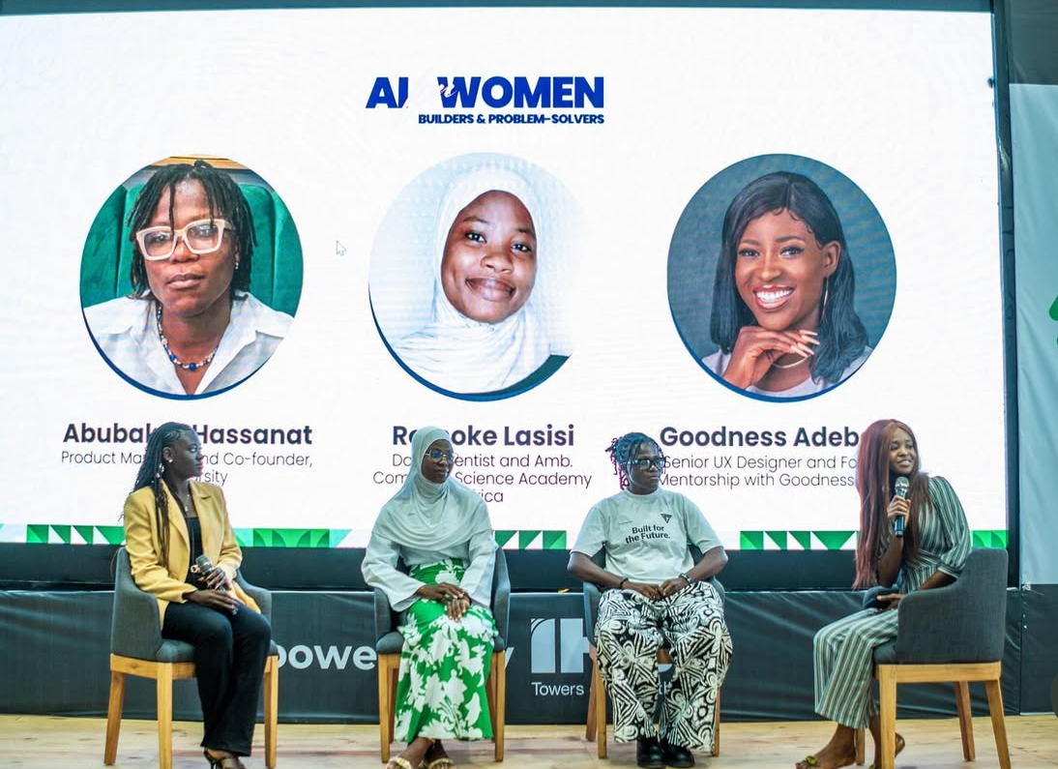
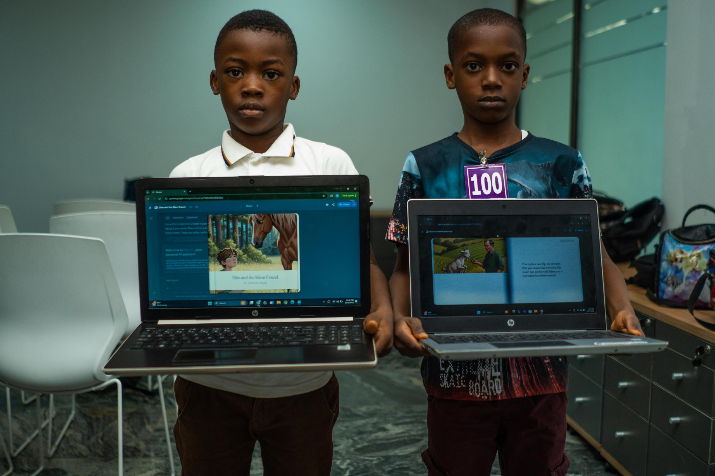
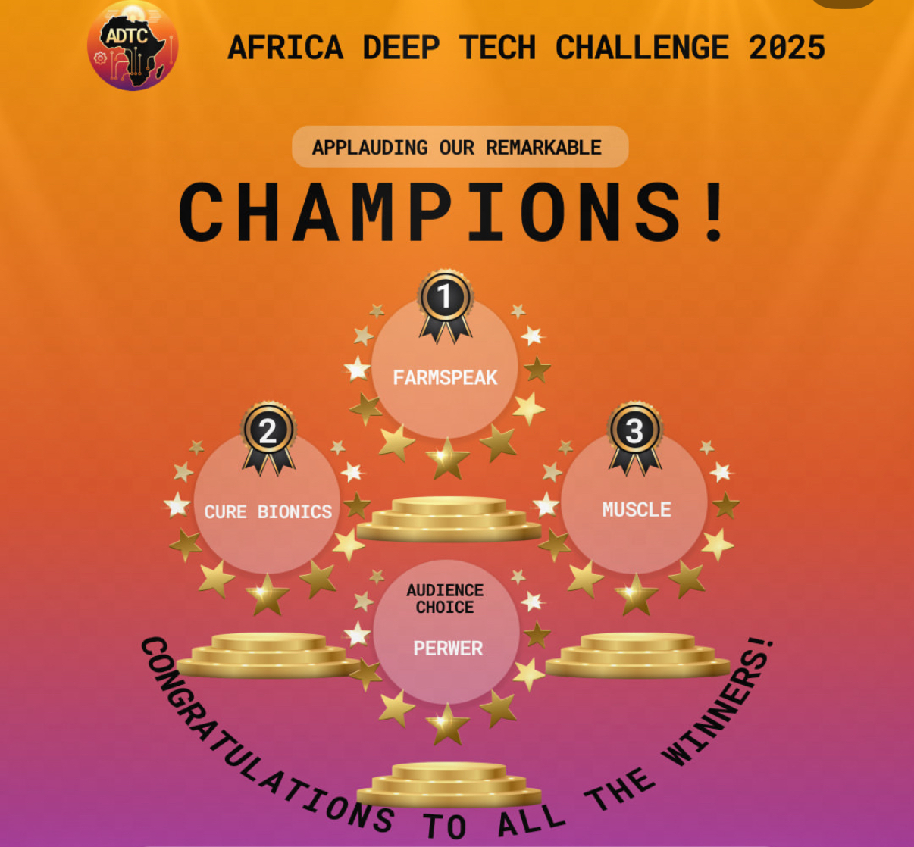
Executive Summary of Activities
Q3 — Deepened Impact & Youth Inclusion (September–October 2025)
Key Highlights
ORBIT Internship Program scaled to 850 interns across 8 universities
AI for Women Bootcamp (105 participants, 48% women)
Creative Tech & Future of Digital Studios event
Learn2Earn Digital Challenge (1000+ participants)
Africa Deep Tech Challenge 2025 — IIH-affiliated startup among winners
AI Independence Bootcamp for Kids with 200 young learners
Managing Director represented IIH at GITEX Africa 2025 (September)
IHS Nigeria Impact Report Event participation reinforced partner visibility
Managing Director spoke at GITEX Africa 2025 on the international panel “One African Silicon Valley or Many?”.

Slide 11
Executive Summary of Activities
Q3 — Deepened Impact & Youth Inclusion (September–October 2025)
Impact Metrics 3,800+ cumulative participants; 1,400+ women & girls trained; 850 remote interns onboarded
Milestones Delivery of UNDP Makerspace Equipment & upgraded outdoor solar infrastructure; Cafeteria fully operational; Expanded national visibility through media and events

Slide 12
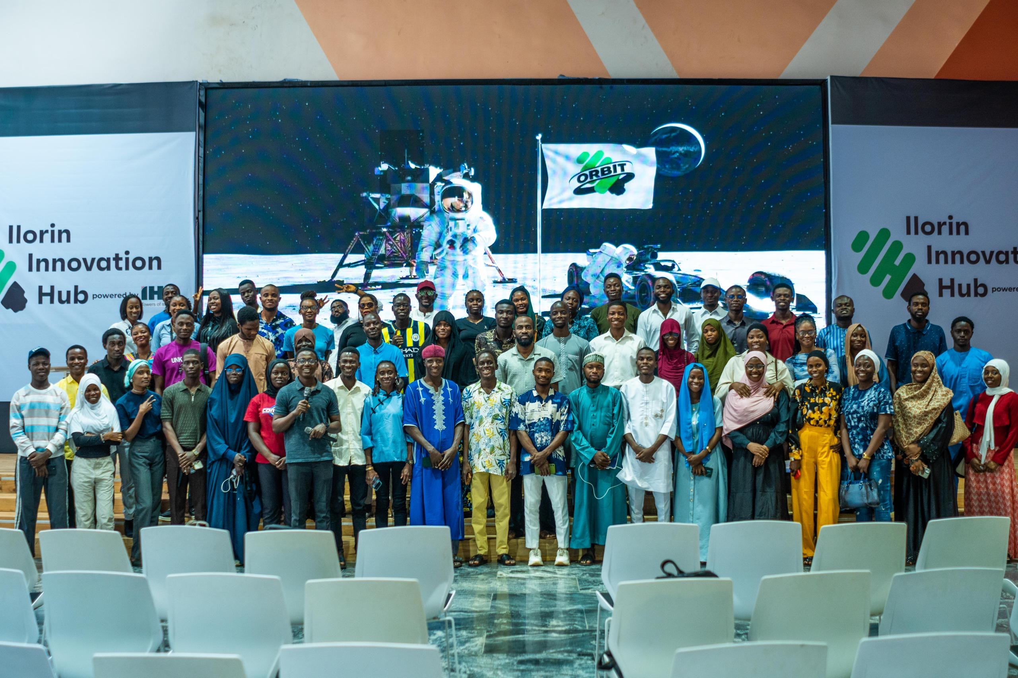
Executive Summary of Activities
Cumulative Impact (February–October 2025)
Category | Cumulative Total
Programs & Events Held | 70+
Total Participants Engaged | 4,800+
Women and Girls Participants | 2,100+
ORBIT Interns Onboarded | 850
Universities & Hubs Engaged | 10+
Startups Showcased | 6
International Events Attended | 3
Partnerships Maintained | 10+
Facility Enhancements | Elevator, Solar, Cafeteria, Makerspace
Staff & Interns | 15 staff, 3 NYSC, 9 interns
Learn2Earn Participants | 1000+
Other Achievements | Africa Deep Tech Challenge 2025 prize winner; Kwara Innovation Challenge & Hackathon; Incorporation of IIH Ltd/Gte; 3rd FETICON Student Colloquium sponsored by IHS Towers

Slide 13
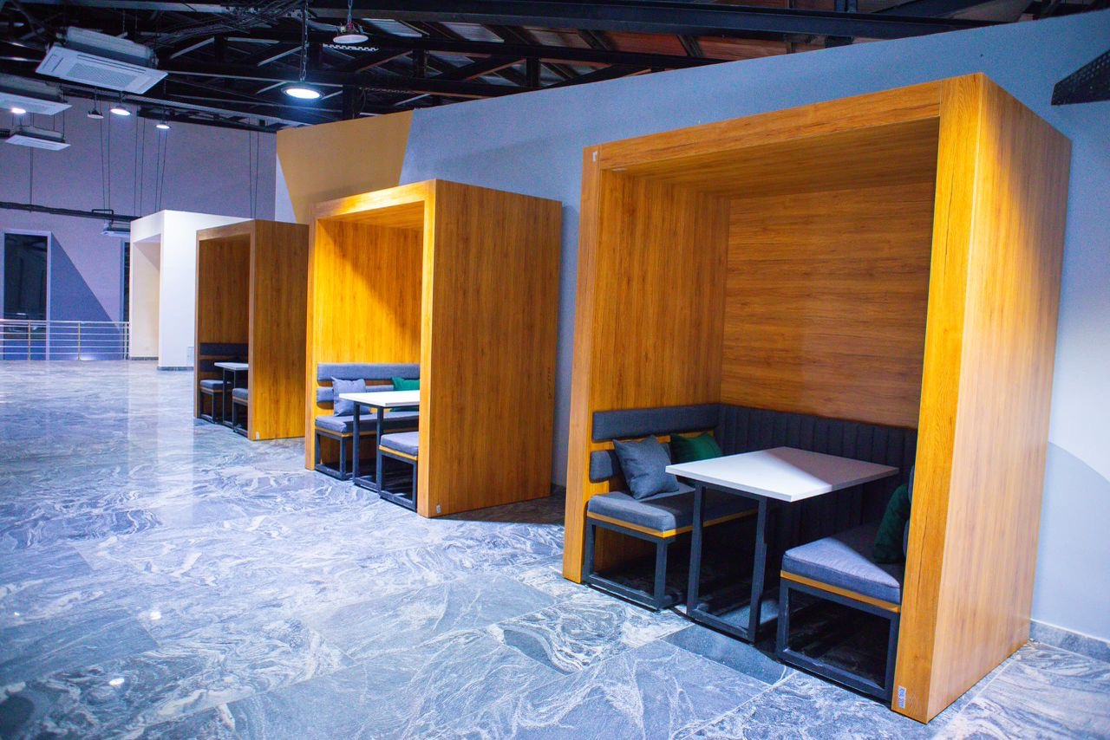
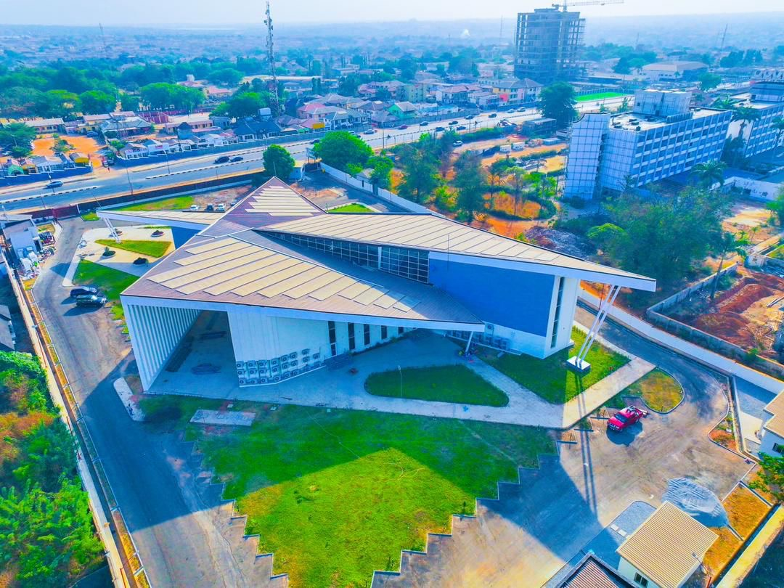
Executive Summary of Activities
Looking Ahead
Kwara AI Summit 2025: Co-developed with IHS Towers to spotlight AI innovation, entrepreneurship, and youth empowerment.
ORBIT 2.0: Expansion to additional universities and specialized tracks.
Ecosystem Growth: Launch of new hackathons, accelerators, and creative-tech programs.
Facility Enhancements: Reception redesign, creative studio launch, and upgraded co-working spaces.

Slide 14

Executive Summary of Activities
Acknowledgement
The management of the Ilorin Innovation Hub expresses sincere appreciation to IHS Towers for its continued partnership, sponsorship, and leadership in advancing innovation, youth empowerment, and digital inclusion in Kwara State.
The milestones achieved between February and October 2025 demonstrate the strength of this collaboration and a shared vision for a sustainable innovation ecosystem in Nigeria.

Slide 15
Thank you.

